Slide 1
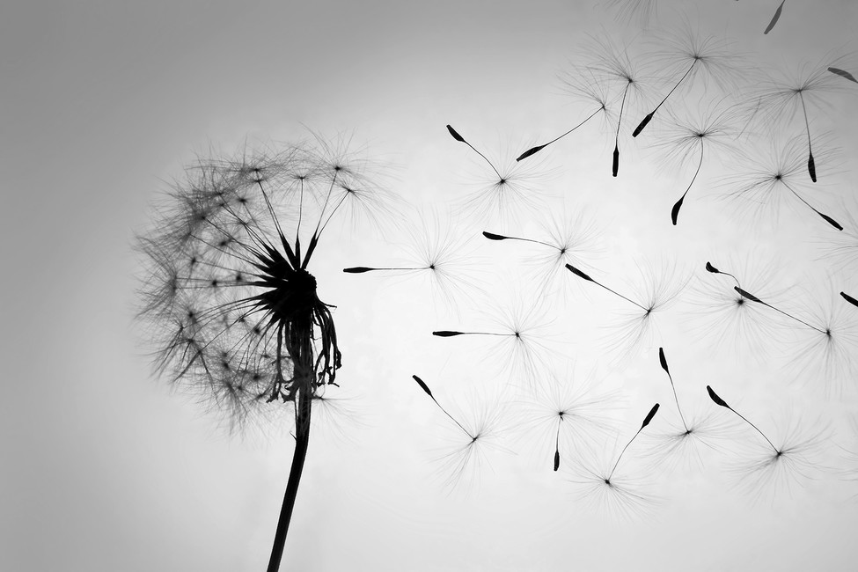

God’s Top Ten For
Stella Maris Pixies
“The thief comes only to steal and kill and destroy; I have come that they may have life, and have it to the full.”
To make a magic porridge pot on an open fire.
Bake a cake.
To write and illustrate our own story book.
Plant some flowers and watch them grow.
Build a den.
Go to a party.
To complete a random act of kindness.
Explore our beautiful home town.
To see a real life wild animal.
To feel loved and know that you are special

